Slide 1
Introduction:
Pokémon franchise: Started in 1996, global powerhouse
Competitive battling scene: Esports industry, $1B+ revenue annually

Slide 2

Pokemon linear regression model.
Introduction: The Pokémon franchise has become a global powerhouse since its inception in 1996. Alongside the popular video games, Pokémon has created a thriving competitive battling scene that rivals other major franchises. With the Esports industry generating over $1 billion in revenue annually, there is a growing demand for data-driven strategies to enhance tournament success.

Slide 3

Central Aim:
Our goal is to assist aspiring competitive Pokémon trainers in selecting winning strategies. As data scientists, we aim to leverage statistical models and algorithms to determine the most viable options for success. By analyzing key factors such as stats, typing, and evolution stages, we can provide insights into which Pokémon are likely to perform well in tournaments.

Slide 4

Problem to be Solved
: Our central problem is to identify the primary stats that contribute to a Pokémon's success, particularly its overall performance (total stats). Additionally, we aim to determine the prevalence of "good" typings and evolution stages that are more likely to yield competitive Pokémon.

Slide 5

Process
We followed a structured approach to address the problem:
1
Part A: API Call & CSV Formation: Utilized PokeAPI to retrieve Pokémon data, including stats, typings, names, total stat, and evolution stage. This information was consolidated into a CSV file for analysis.
2
Part B: Cleaning and EDA: Conducted data cleaning and exploratory data analysis to understand the dataset better. This involved examining statistics, generating visualizations, and identifying outliers.
3
Part C: Quick SQL Demo: Demonstrated the ability to store data in a SQL database using the "fullgen_tophalf_pokemon.csv" file.
4
Part D: Regression Model: Utilized linear regression, ridge, and lasso models to determine the relationship between Pokémon stats and their overall performance.
5

Slide 6
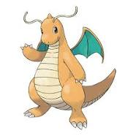
Results and Considerations:
Pokémon Typings: The dragon type exhibited higher average total stat values, indicating its competitive viability. Conversely, the bug type displayed lower average total stat values.
Powerful Types: Based on an average power metric (combined attack and special attack), the top three powerful types were identified as psychic, flying, and dragon. Conversely, the three weakest types were poison, grass, and ground.
Typing Prevalence: Water, psychic, and grass were the three most common types among Pokémon. In contrast, ice, fairy, and bug were the least common types.
Correlations: There may be a correlation between the lower representation of bug types and their lower total stat values. Conversely, the higher prevalence of dragon types could contribute to their higher total stat values.

Slide 7
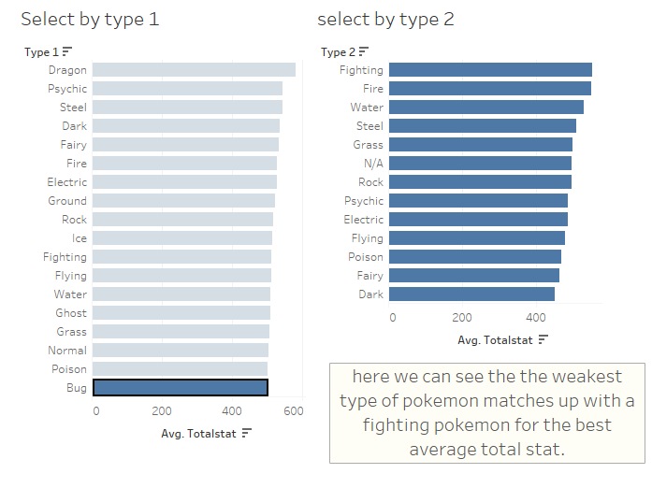
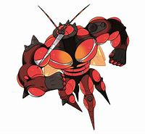
Pokemon Example with Data: Buzzwole
When looking on google to confirm the findings I was able to come across Buzzwole, who visually fits the criteria of bug pokemon with high fighting ability.

